Slide 1

TRAINING EVENT –URBANREC
24/07/2019 - Las Naves- Valencia (Spain)
Los nuevos retos en la gestión de Voluminos.
Javier Ferrer, Servicio de Medio Ambiente Diputación de Valencia.

Slide 2
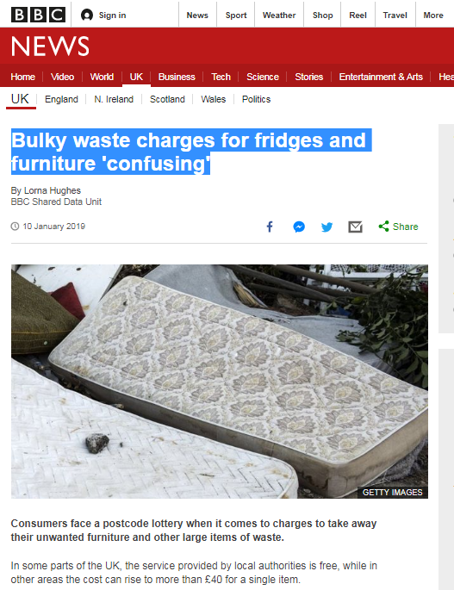
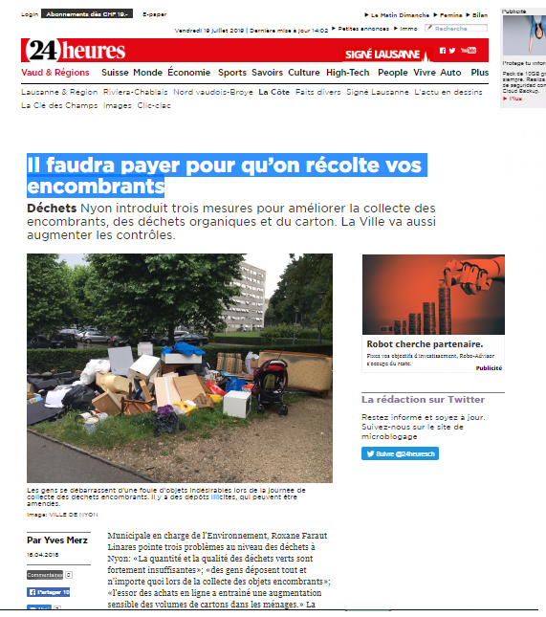
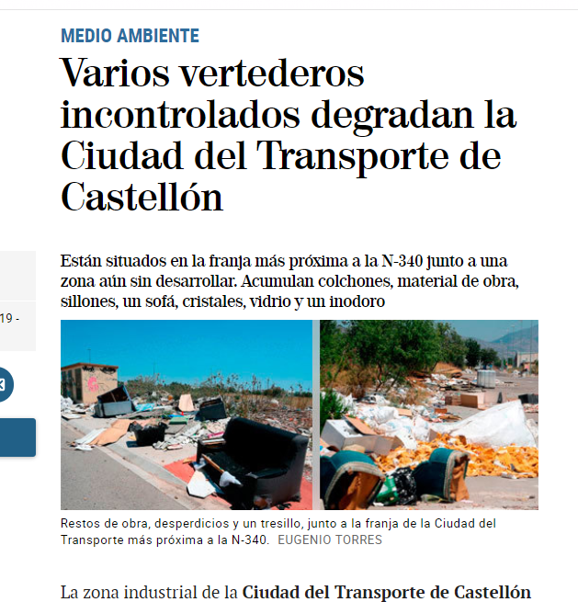

Gestión de Voluminosos- reto ambiental a nivel europeo.
En Europa más del 60% de los residuos voluminosos se depositan en vertedero. (Problemática común,19 Mt) A nivel nacional 10% RD.

Slide 3
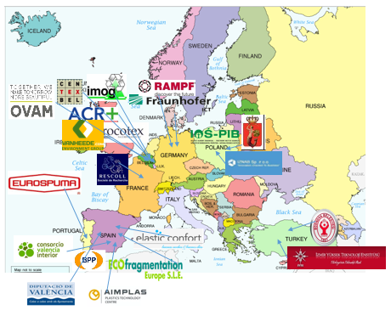
Como vamos a conseguirlo
Diseño y desarrollo de un nuevo modelo de gestión de voluminosos a nivel europeo, transformar los residuos en recursos.
Consorcio Europeo: Instituto Tecnológico del Plástico.
21 socios de 7 países: Centros Tecnológicos , PYMEs, grandes empresas, entidades locales.
CV: CVI, Diputación de Valencia, Ecofrag, BBP, Colchones Delax.
Acciones demostrativas: Bélgica, Polonia, Turquía y España (P. Valencia)
Seleccionado CE, Programa Horizonte 2020- (86%) 8.618.970,39€
Plazo de ejecución: 42 meses (2016-2019)
Notes:
The URBANREC consortium brings together a wealth of expertise and resources within the areas of: waste management, legislation, logistics, reuse, collection, fragmentation, special bulky waste treatments, educational programs concerning waste management, etc. The presence of main actors in the whole value chain demonstrates the critical mass of complimentary resources that will enable the URBANREC project to achieve its targeted societal, industrial, and scientific breakthroughs and commercial success.
URBANREC partnership is composed by 21 organisations from 7 EU contries
7 SME
2 IND
5 RO
7 OTHER
URBANREC project partners represent the whole bulky waste value chain, ensuring the success of the project and its subsequent implementation at EU level.
The participation and leadship of Public bodies/Legal authorities and SMEs in URBANREC is clear as they represents 66%of the partnership.
URBANREC consortium has a well-balanced composition (21 partners, from 7 countries, being 5 RO, 7 SMEs, 2 Large IND, and 7 OTHER).
URBANREC project do not forget a key player: the citizens. Their participation in the management of bulky waste, delivering them in an appropriate way, allows further optimization of recovery.

Slide 4
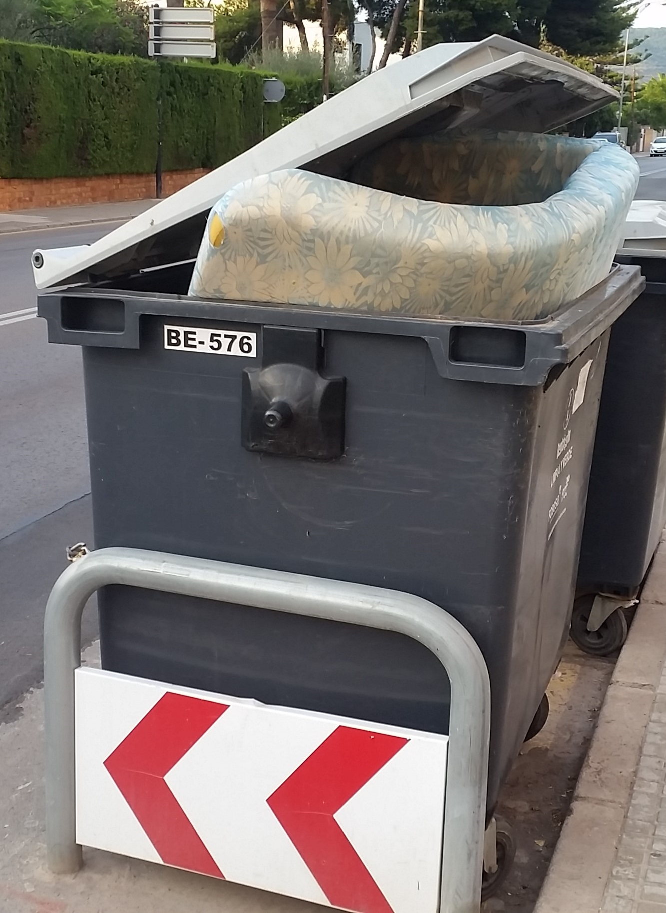
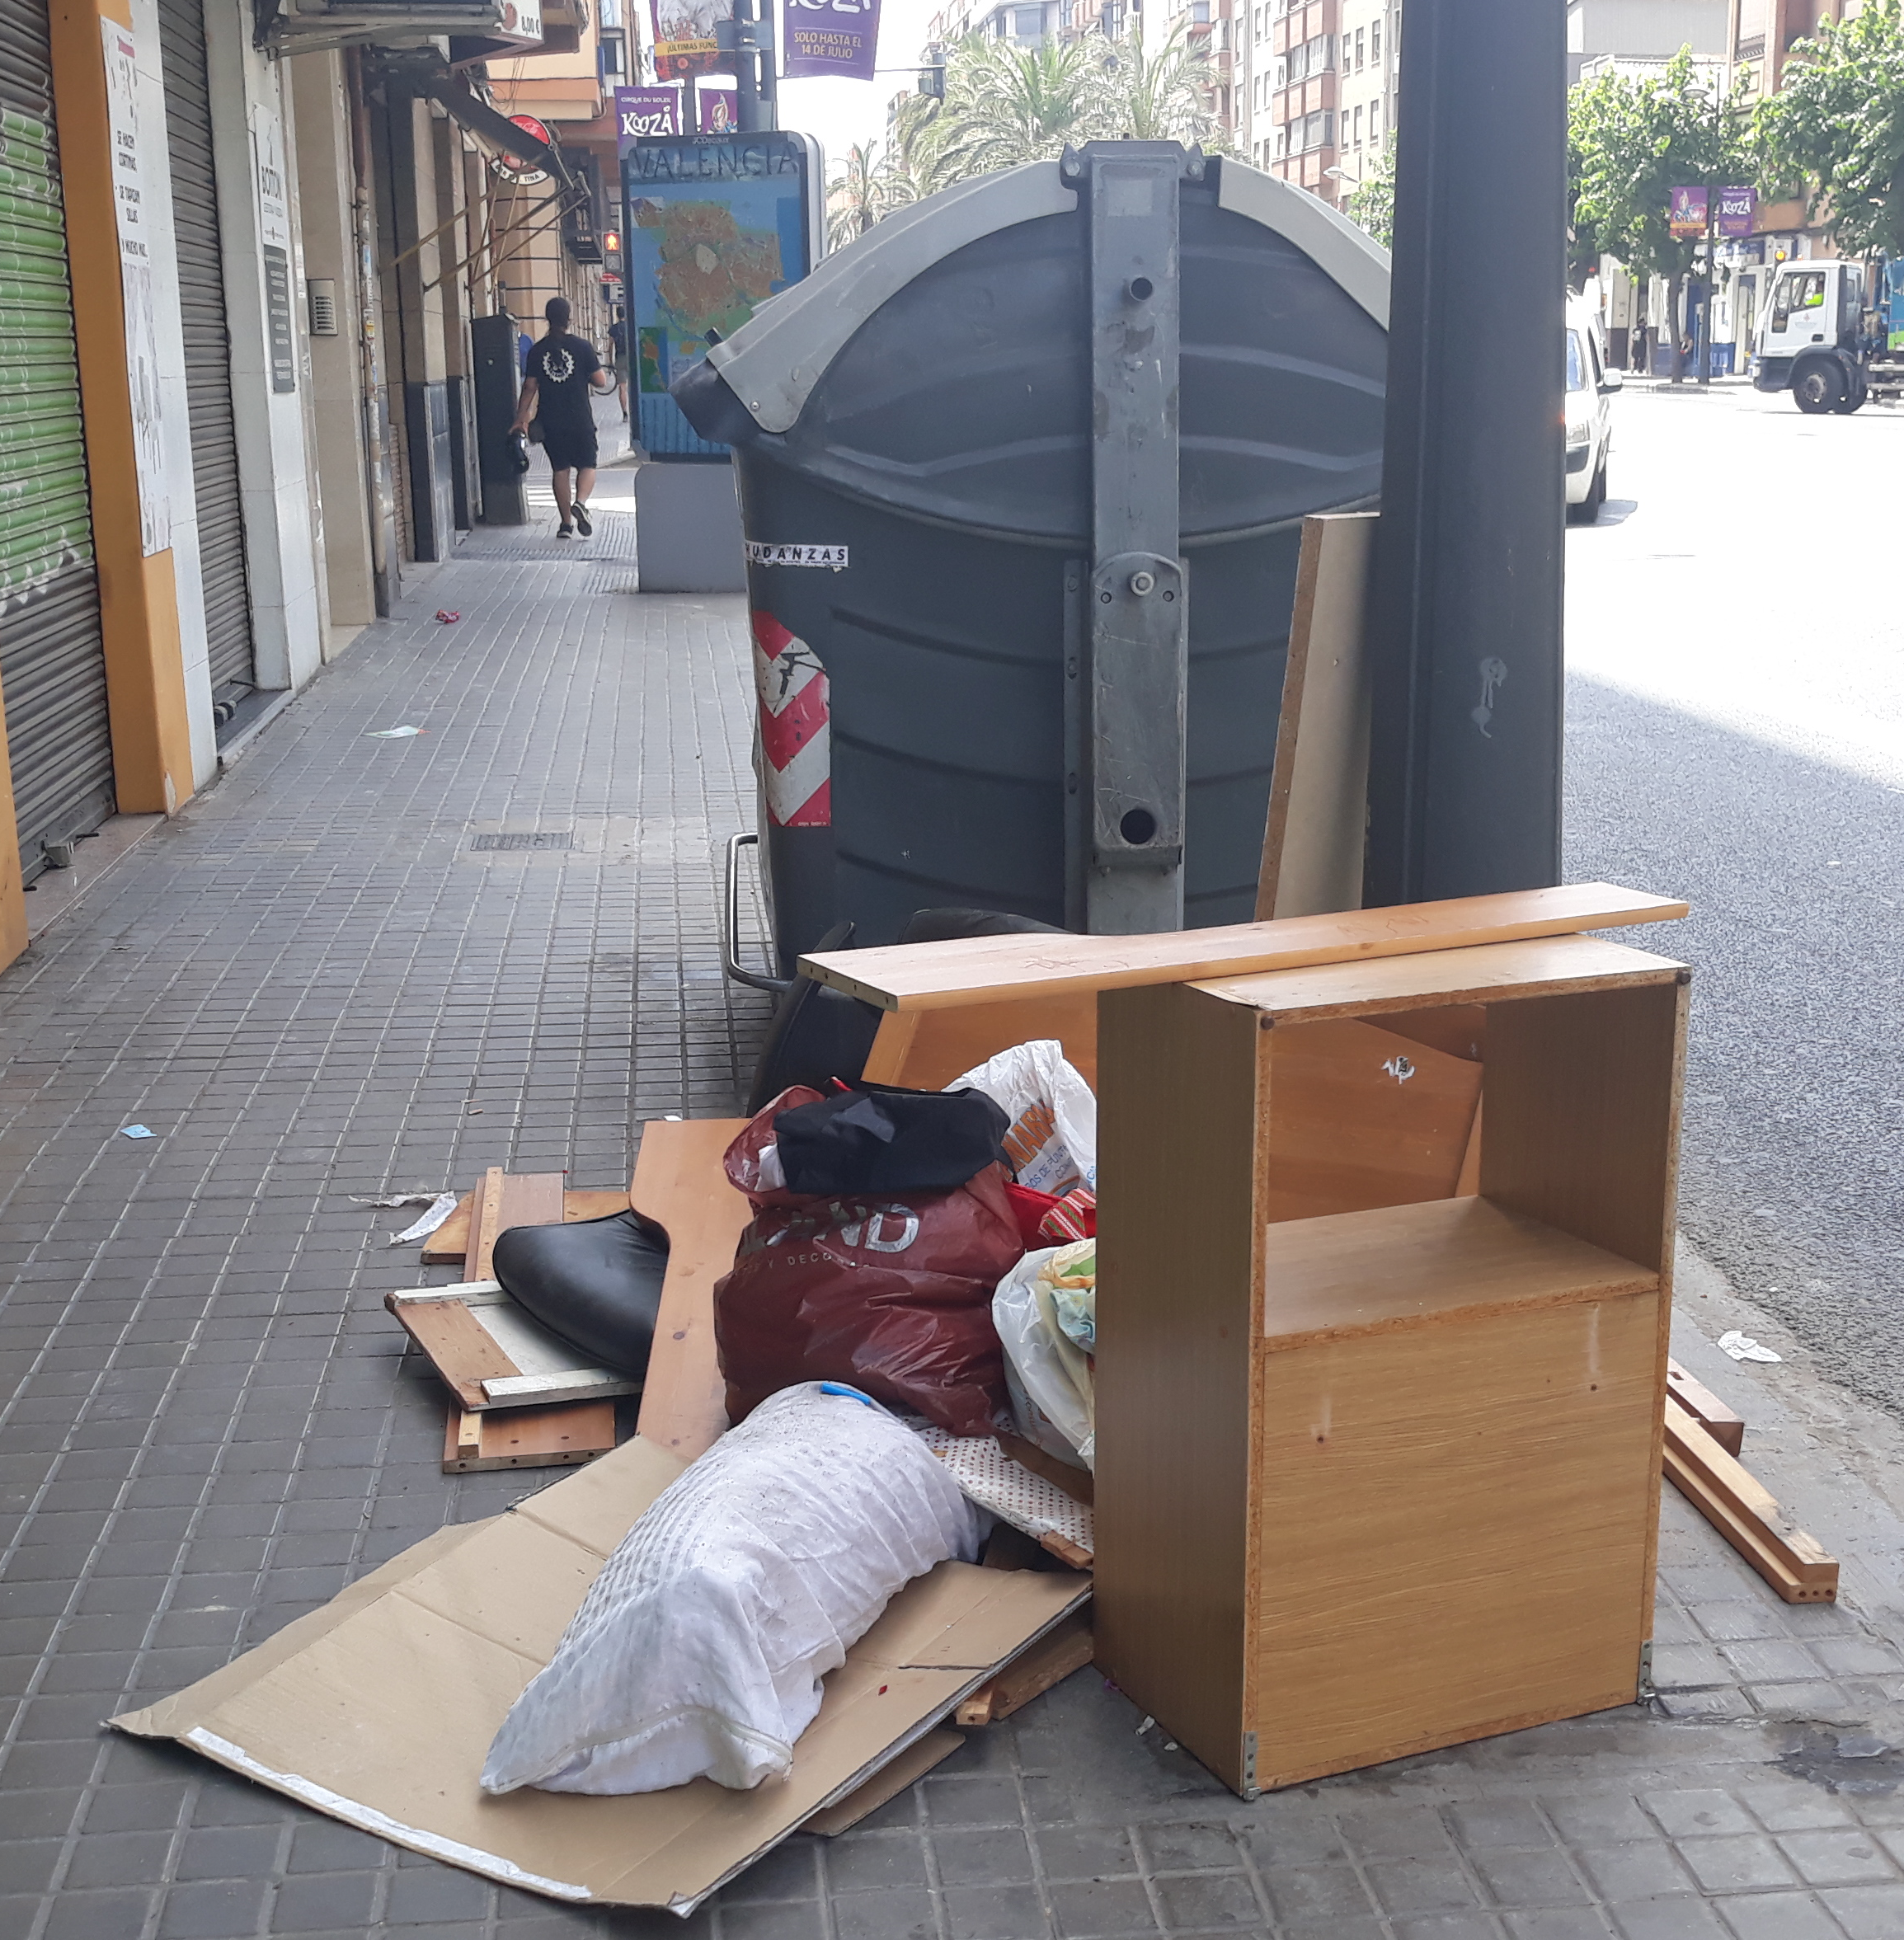
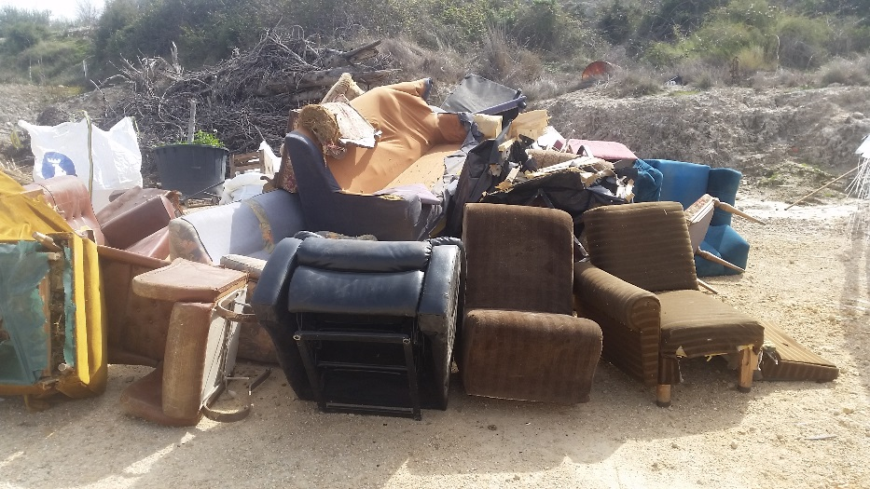
Principales retos en la gestión de los voluminosos.
Retirada del residuo.
Escasa colaboración ciudadana.
Información para la correcta retirada a nivel local.
Recogida/ transporte selección en ecoparque: tipología del residuo: gran volumen y peso.
Tratamiento: composición heterogenia de los enseres, dificulta valorización.
Principal opción triturado.
Escasa reutilización.

Slide 5
Como vamos a conseguirlo
Diseño y desarrollo de un nuevo modelo de gestión de voluminosos a nivel europeo, transformar los residuos en recursos.
Propuesta mejoras de gestión : separación en origen/apoyo para la implicación de la ciudadanía en la correcta retirada.
Tecnológica: nuevos sistemas de tratamiento y alternativas valorización final.
Notes:
The URBANREC consortium brings together a wealth of expertise and resources within the areas of: waste management, legislation, logistics, reuse, collection, fragmentation, special bulky waste treatments, educational programs concerning waste management, etc. The presence of main actors in the whole value chain demonstrates the critical mass of complimentary resources that will enable the URBANREC project to achieve its targeted societal, industrial, and scientific breakthroughs and commercial success.
URBANREC partnership is composed by 21 organisations from 7 EU contries
7 SME
2 IND
5 RO
7 OTHER
URBANREC project partners represent the whole bulky waste value chain, ensuring the success of the project and its subsequent implementation at EU level.
The participation and leadship of Public bodies/Legal authorities and SMEs in URBANREC is clear as they represents 66%of the partnership.
URBANREC consortium has a well-balanced composition (21 partners, from 7 countries, being 5 RO, 7 SMEs, 2 Large IND, and 7 OTHER).
URBANREC project do not forget a key player: the citizens. Their participation in the management of bulky waste, delivering them in an appropriate way, allows further optimization of recovery.

Slide 6
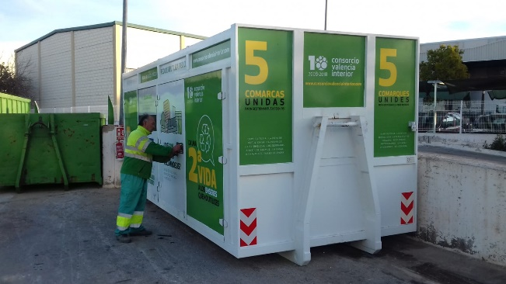
Propuesta Urbanrec- Mejoras para la gestión.
Campañas sensibilización.
Mejora procesos de retirada
Selección en materiales/ Ecoparque.
Reutilización.
Acciones sensibilización en 20 municipios.
Apoyo a los municipios para la mejora información ciudadana.
(Material Informativo)
Diseño de guías de buenas practicas para el desarrollo del modelo Urbanrec.
Desarrollo de medidas de recompensa ciudadana fomento de la reutilización y el reciclaje de residuos voluminosos en entornos urbanos.
Recomendaciones para la mejora en transporte y gestión en ecoparque.
Training Event.
Creación nuevas fracciones
Ecoparque.
Entrega mobiliario urbano reciclado en los municipios.
Inactiva Recircula

Slide 7

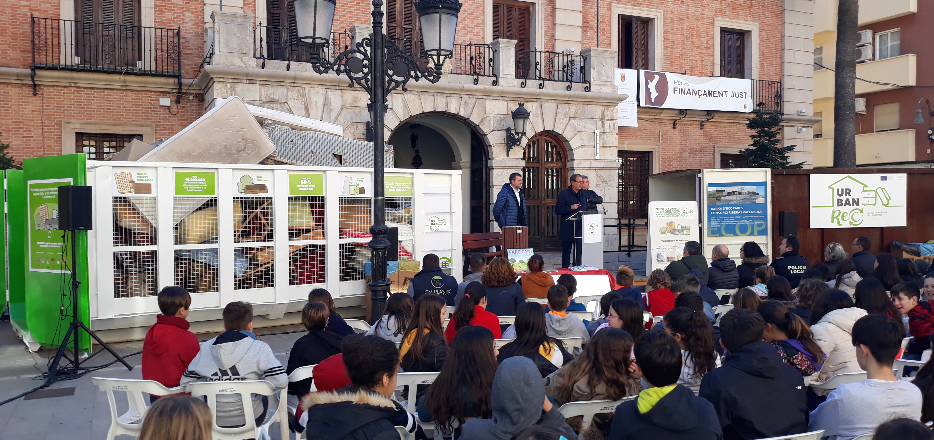
Apoyo en la gestión del voluminosos.
Sensibilización ambiental
Material Informativo para municipios.

Slide 8

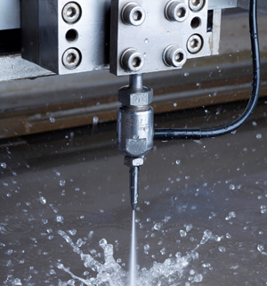

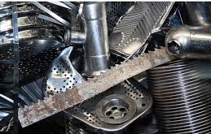
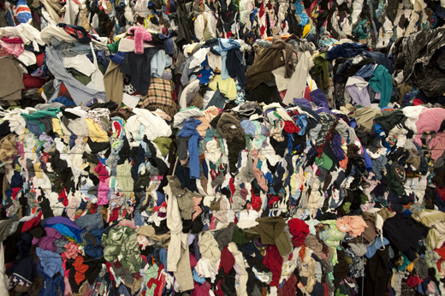
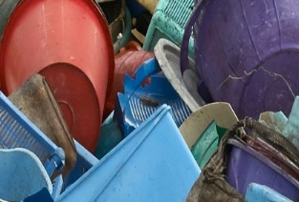
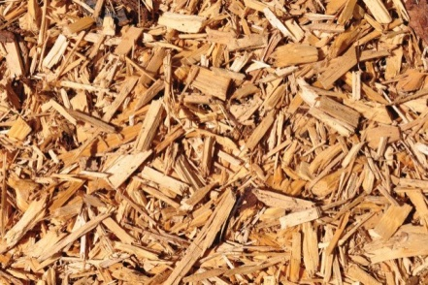
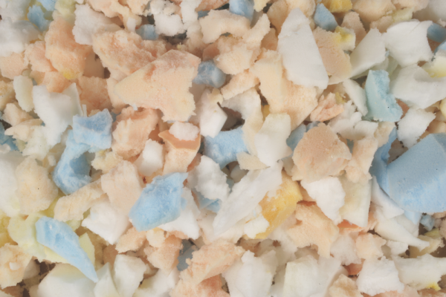
Soluciones tecnológicas, tratamiento corte 3D
RESIDUOS NO REUTILIZABLES
METAL
TEXTIL
PLÁSTICOS MADERA ESPUMAS
NUEVOS MÉTODOS DE TRATAMIENTO
SEPARACIÓN TRITURADO
Notes:
URBANREC project will demonstrate specific solutions for bulky waste management challenges. In a first step, technical solutions will be implemented in two representatives’ European regions; Valencia (Spain) and Harelbeke-Flanders (Belgium). Then, the obtained results will be transferred to the other regions, this multidisplinary approach will be used to design a bulky waste management system guide to be implemented at European level.
In Harelbeke-Flanders, advance technologies such as the adaptation of existing applications for mobile phones and a developed customer portal services will be implemented. This will facilitate data collection which will be used to bring closer the gap between citizens and bulky waste management actors and to implement educational programs and incentives (e.g. tax reduction, free municipal services…) for enhancing bulky waste re-use and recycling. In Valencia new grinding method will be stablished to decrease grinding costs and contribute to obtain pure fractions coming from bulky waste what makes easy to design profitable CA sites. Existing valorisation routes (solvolysis, rebonding, unravelling …) will be adapted to waste streams coming from bulky waste and demonstrators will be manufactured and validated in operational environment.

Slide 9
Soluciones tecnológicas, valorización.
Alternativas de valorización

Slide 10





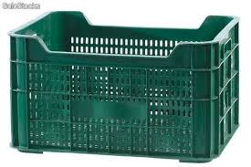


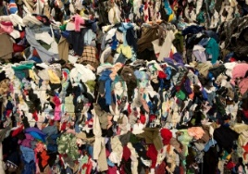


Tecnología de Hidrogasificación catalítica con plasma
PLÁSTICOS
ESPUMA PU
TEXTILES
MADERA
METILAL – DISOLVENTES QUÍMICOS

Slide 11



RESIDUOS VOLUMINOSOS FUERA DE USO
PLÁSTICOS
TEXTILES

Slide 12
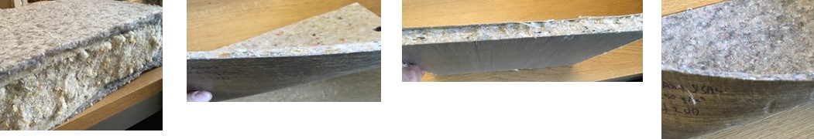
RESIDUOS VOLUMINOSOS FUERA DE USO
TEXTILES
PANELES DE AISLAMIENTO TÉRMICO /ACÚSTICO FIELTROS TEXTILES

Slide 13


Como vamos a conseguirlo
SOCIOS URBANREC + ACTOR CLAVE : LOS CIUDADANOS
Notes:
The URBANREC consortium brings together a wealth of expertise and resources within the areas of: waste management, legislation, logistics, reuse, collection, fragmentation, special bulky waste treatments, educational programs concerning waste management, etc. The presence of main actors in the whole value chain demonstrates the critical mass of complimentary resources that will enable the URBANREC project to achieve its targeted societal, industrial, and scientific breakthroughs and commercial success.
URBANREC partnership is composed by 21 organisations from 7 EU contries
7 SME
2 IND
5 RO
7 OTHER
URBANREC project partners represent the whole bulky waste value chain, ensuring the success of the project and its subsequent implementation at EU level.
The participation and leadship of Public bodies/Legal authorities and SMEs in URBANREC is clear as they represents 66%of the partnership.
URBANREC consortium has a well-balanced composition (21 partners, from 7 countries, being 5 RO, 7 SMEs, 2 Large IND, and 7 OTHER).
URBANREC project do not forget a key player: the citizens. Their participation in the management of bulky waste, delivering them in an appropriate way, allows further optimization of recovery.

