Slide 1

New approaches for the valorisation of URBAN bulky waste into high added value RECycled products
URBANREC
Project on Urban bulky waste
11 September 2017
Brussels – PPI4Waste final conference

Slide 2
The project
Horizon 2020 - Innovation Action (IA)
Duration: 42 months: June 2016 to Nov 2019
Objective: implement an eco-innovative and integral bulky waste management system
Improve re-use
Dismantlements
Training
Source separation
New valorisation routes
EU regulation
Notes:
Funding scheme: Innovation action
(Funding is more focused on closer-to-the-market activities. For example,
prototyping, testing, demonstrating, piloting, scaling-up etc. if they aim at
producing new or improved products or services)
3.5 years

Slide 3
Background
Currently more than 60% of bulky waste -> landfill
For various reasons:
  Lack of stringent legislation
  Issues with logistics
  Cost-ineffective valorisation methods
  Lack of market outcomes
Notes:
More than 60% of bulky waste end up in landfills (of course with variations across countries in line with the average recycling rates: 70% in BE, 25-30% in ES, 20% in PL, less than 5% in TR)

Slide 4
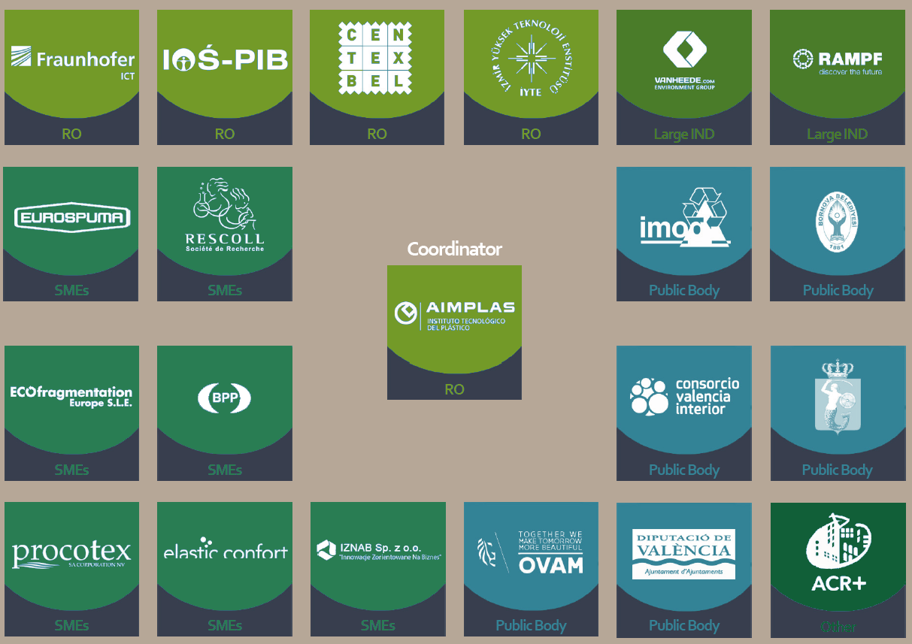
Partnership
Notes:
21 partners from 7 countries:
5 research centers, 1 NGO, 6 government institutions, 7 SMEs, 2 large industrial partners
Project leader: AIMPLAS

Slide 5
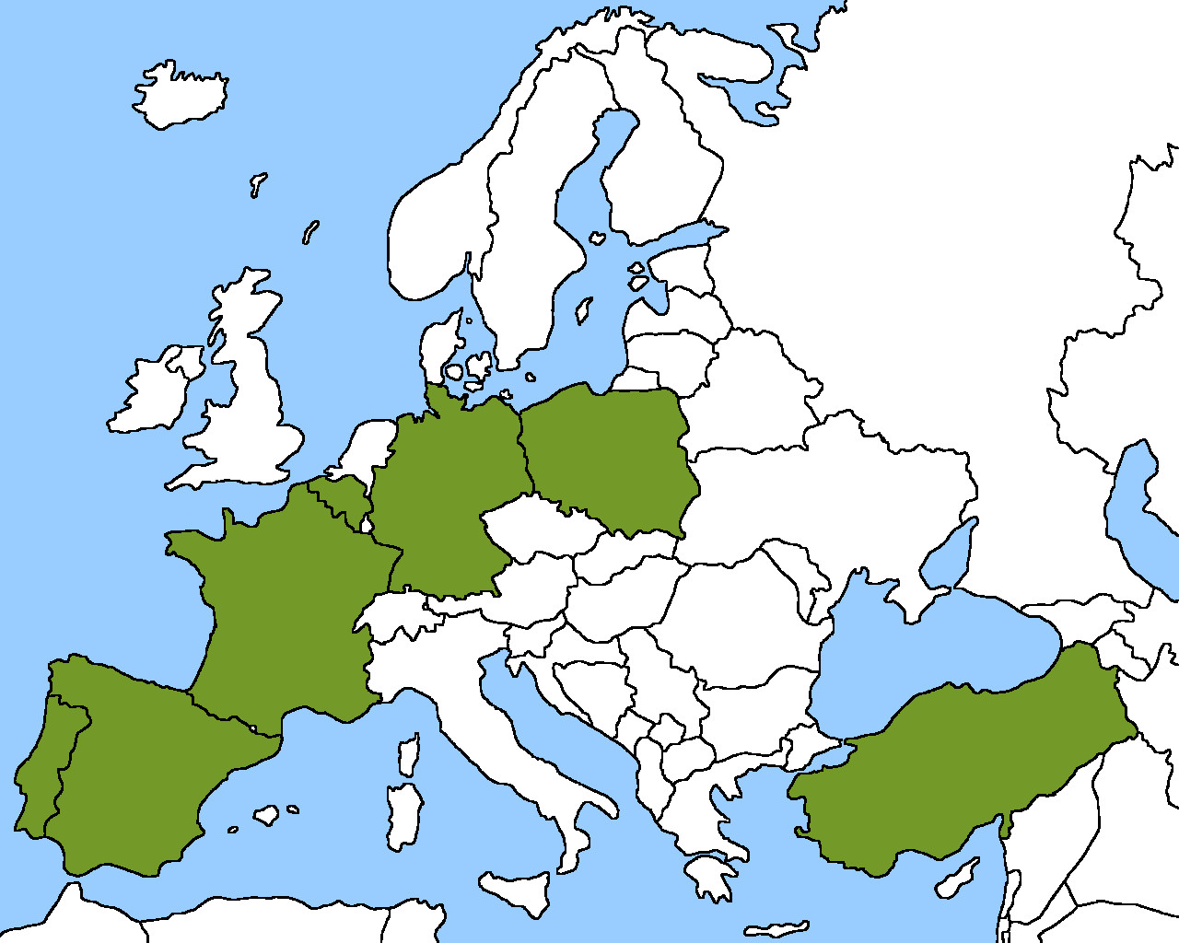
Partnership

Slide 6

Partnership
Notes:
4 countries with partners representing public authorities: Belgium, Spain, Poland and Turkey

Slide 7
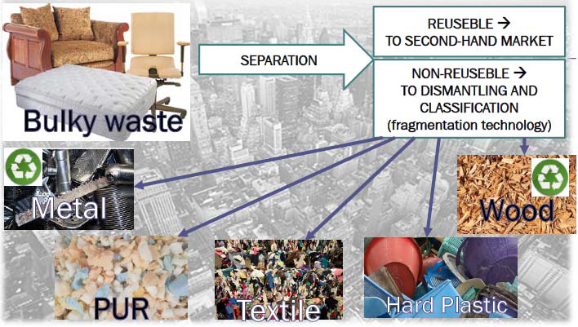
Approach
IMPROVE LOGISTC
Improve collection and separation
Notes:
The first step is to improve collection of bulky waste and separation at source in order to direct the reusable materials to the second-hand market and the non-reusable – to dismantling and classification
The Flanders region in BE will serve as a case study territory to enhance reuse: this will include contacting social economy actors, establishing reuse networks, launching a mobile application to inform the citizens

Slide 8
Outcomes
Improve logistics
Waste application and customer portal
Enhance re-use with new networks
Improve separation
Assess and improve civic amenity sites
New dismantlment technology for composite products to optimise the process
New valorisation routes
Adaptation and improvement of existing technologies applied to separated materials
On several fractions: PU foams, mixed textiles, hard plastics and wood
Notes:
As a second step comes the actual handling of the bulky waste which cannot be reused.
For this the focus is on 4 material streams which are seen as most problematic (because it is not cost-effective to handle them at the current moment and there is a lack of final applications): PU foam, mixed hard plastics, mixed textiles and wood.
Existing technological uses/ valorisation routes will be adapted to waste streams coming from bulky waste and demonstrators will be manufactured and validated in an operational environment. In the CAS of Valencia, two technologies (laminated cutting technology and Catalytic Hydro-gasification with Plasma) will be implemented to demonstrate their technical and economic feasibility

Slide 9

Acknowledgments
URBANREC project is an European project which proposal was submitted to Call H2020-WASTE-2015, “A resource to recycle, reuse and recover raw materials”, Topic WASTE-6a-2015 “Eco-innovative solutions” and has received funding from the European Union’s Horizon 2020 research and innovation programme under grant agreement nº 690103.

Slide 10
Thank you for your attention !

