Slide 1
Adhesive and foams obtained from secondary polyols
Notes:
This presentation is based on results obtained in URBANREC’s deliverable 3.1: “Adhesive and foams obtained from secondary polyols”, which aims the feasibility of demonstrating the technical feasibility of solvolysis route to obtain adhesives and foams using secondary polyols obtained from PUR foam coming from bulky waste.

Slide 3
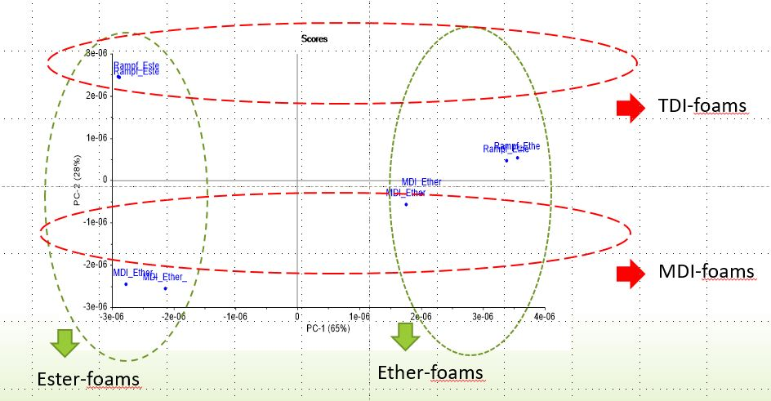
Post-consumer foam separation
Separation and analyse of collected post-consumer foam in terms of the chemical composition of the polyol and isocyanate educts using NIR spectroscopy techniques
Notes:
The collected post-consumer foam waste was analysed via NIR spectroscopy techniques to separate foam in terms of the chemical composition of the polyol and isocyanate educts.
As seen in Figure 1 the different foam materials could be separated via NIR spectroscopy and PC analysis. The separation before the chemical recycling process leads to higher secondary polyol quality.

Slide 4
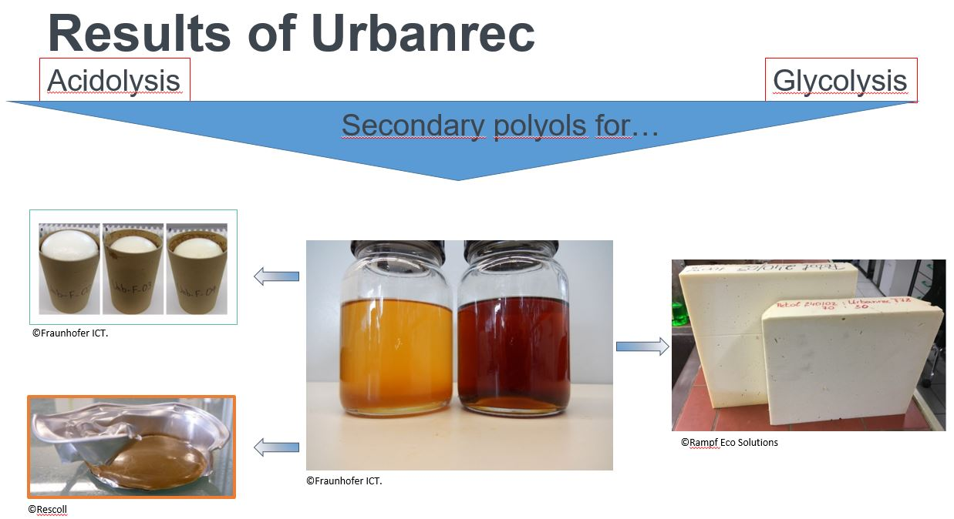
Manufacturing of secondary polyols
2 solvolysis process leading to different valorisation routes of secondary polyols :
Acidolysis
Glycolysis
insulation panel applications
viscoelastic mattresses top layer foam
PUR hot-melt adhesive
Possible use of obtained polyol in flexible and rigid foam application and hot-melt adhesive
Notes:
Rampf used two different solvolysis process, acidolysis and glycolysis.
The obtained polyols from acidolysis was incorporated in viscoelastic mattresses top layer foam and used for PUR hot-melt adhesive
The secondary polyol from glycolysis process is used for insulation panel applications.
The obtained polyol from post-consumer mattresses waste could be used successfully in flexible and rigid foam application and also for hot-melt adhesive.

