Slide 1
URBANREC training material:
Definition of the starting situation in URBANREC regions
Notes:
This presentation is based on results obtained in URBANREC’s deliverable 1.1: “definition of the starting situation in URBANREC regions”, achieved within the framework of task 1.1 which aim is to define an evaluation of bulky waste management in the 4 regions involved in URBANREC at the beginning of the project.

Slide 2
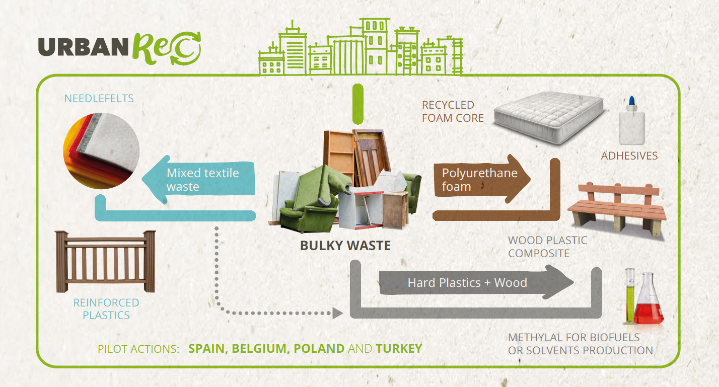
Reminder: Project Overview
Notes:
URBANREC is implementing an eco-innovative and integral bulky waste management system (enhancing prevention and reuse, improving logistics and allowing new waste treatments to obtain high added value recycled products) and demonstrating its effectiveness in different EU regions, including a roadmap to improve Eco-efficiency on European waste management & Pro-active standardization strategy.

Slide 3
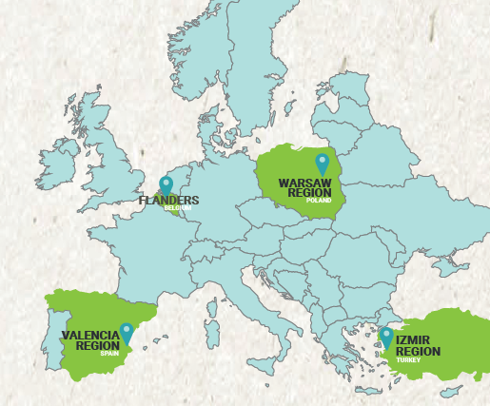

Bulky waste management
Notes:
Deliverable 1.1 summarizes the current situation of bulky waste management in the 4 regions participating in URBANREC project (Flanders, Warsaw, Izmir, Valencia) focused on: collection, treatment schemes and reuse.

Slide 4
Flanders (Belgium)
Well-established infrastructure for collection and treatment
Civic Amenity Sites (CAS): 95.8% of the population living within 5 km of a CAS
Among the success factors: inclusion of reuse in household waste management policy + strong presence for the reuse sector
Notes:
Flanders (Belgium) has an advanced bulky waste management system with a very well-equipped infrastructure for collection and treatment of bulky waste. In Flanders, strict rules exist on the establishment of civic amenity sites (CAS), covering 95.8% of the population living within 5 km of a CAS.
Twenty years of experience and several key-success factors such as the inclusion of reuse in the local household waste management policy in Flanders result in a high presence for the reuse sector.

Slide 5
Valencia (Spain)
Extensive network for bulky waste management, but low number of Civic Amenity Sites in remote areas
No regulation about collection by reuse organisations
Critical point: high amount of non-separated bulky waste (mixed bulky waste)
Notes:
Valencia (Spain) has an extensive network for bulky waste management, thus increasing the amount which they can collect and avoiding illegal dumping. One of the problems with reference to the civic amenity sites in Spain is the low availability of them in remote areas, that is to say, small towns far from large urban centres. In Spain, reuse is organized through non-profit organizations but there is no control from the government on the amounts collected because there is no regulation about this type of collection.
One of critical points is derived from the high amount of non-separated bulky waste (mixed bulky waste), counted in Spain and Belgium. At the moment there is still material that is destined to landfill or incineration that has a high potential of another type of recovery or reuse.

Slide 6
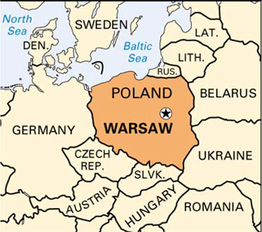
Warsaw (Poland)
Less presence of Civic Amenity Sites than in Spain or Belgium
Good door-to-door collection system
Treatment only available through sorting centres, but no other systems such as reuse
Notes:
In Warsaw (Poland) compared to Spain or Belgium has less availability of civic amenity sites, the low number of CAS is offset by a good door-to-door collection system.
The bulky waste treatment in Warsaw is only available through sorting centres but no other systems such as reuse.

Slide 7
Province of Izmir (Turkey)
2 methods: collection on demand and kerbside collection
Establishing Civic Amenity Sites is a governmental objective
Most of the bulky waste is destined to landfill
Notes:
In the Province of Izmir (Turkey), only two methods are available (collect on demand and kerbside collection), in which the civic amenity site is excluded.
The government of Turkey has targets about specific bulky waste to establish CAS all over the country.
Concerning the different types of methods in Province of Izmir most of the bulky waste is destined to landfill. In the District of Bornova (Turkey) there is only one reuse centre reducing the amount of bulky waste destined to worse treatment methods but not enough to cover the entire population.

Slide 8

Acknowledgments
URBANREC project is an European project which proposal was submitted to Call H2020-WASTE-2015, “A resource to recycle, reuse and recover raw materials”, Topic WASTE-6a-2015 “Eco-innovative solutions” and has received funding from the European Union’s Horizon 2020 research and innovation programme under grant agreement nº 690103.

Slide 9
Thank you for your attention
www.urbanrec-project.eu

