Slide 1
Fibre reinforced PP materials from recycled textiles
Notes:
This presentation is based on results obtained in URBANREC’s deliverable 3.3: “Fibre reinforced PP materials from recycled textiles”, achieved within the framework of task 3.4 “Industrial manufacturing and validation of short fibre reinforced PP composites (FRC).” This task was accomplished by a close collaboration of the partners involved. VANHEEDE (task leader) conducted additional clean-up of the rigid plastics fraction from bulky waste obtained in WP2, while PROCOTEX prepared the textile fibres by controlled fractioning to obtain fibre lengths of 1 to 6 mm. Moreover, fibre granulation tests were carried out in order to supply better dosable fibres. Finally, CENTEXBEL performed compounding trials in order to optimize the FRC composition.

Slide 3
Clean-up of the recycled plastics fraction – Why?
A fraction of the separate collection of bulky waste in Belgium, is composed of mixed rigid plastics:
different polymer types (including PP, PE, PVC, ABS, PS, PA, PC, PMMA, etc.);
different production types (such as extrusion, blow moulding, injection moulding, etc.)
contamination with metals, wood, stones, etc.
Additional clean-up is needed
Notes:
A fraction of the separate collection of bulky waste in Belgium, is composed of mixed rigid plastics. This is a mixture of different polymer types (including PP, PE, PVC, ABS, PS, PA, PC, PMMA, etc.) on the one hand and a mixture of different production types (such as extrusion, blow moulding, injection moulding, etc.) on the other hand. Moreover, the mixture is also contaminated with metals, wood, stones, etc. Thus, for the valorisation of this particular bulky waste fraction further clean-up was performed by VANHEEDE

Slide 4
Clean-up of the recycled plastics fraction - Presorting
Sorting into different polymer grades
Cutting the materials into pieces of ca 10-15 cm
RESULTS: 71% polyolefin (PO) materials
Notes:
In a first step, the mixed rigid plastic fraction obtained from bulky waste was sorted into different polymer grades. Second step is cutting the materials into pieces of ca 10-15 cm (as described in WP2). The presorting resulted in 71% polyolefin (PO) materials of which the different fractions were further processed in the recycling line for PO plastics.

Slide 5
Clean-up of the recycled plastics fraction – Treatment steps
Size reduction;
Washing and flotation;
Removal of the different metal fractions
Regrinding
Dedusting
Notes:
The treatment includes size reduction, washing and flotation, removal of the different metal fractions (ferro and non-ferro), regrinding and dedusting. The PO injection moulding fraction (PO mix, see Figure 2 right) is a blend of PP and PE which could already be used in plastic processing, however the mix was further purified to a 98% PP fraction in order to increase the material value. The start mix and sorted PP fraction of the PO injection moulding grade were processed via melt filtration to remove any residual non-melting impurities that could damage pilot scale equipment and/or would impair the FRC’s mechanical properties. The resulting grades were thoroughly characterized and the mechanical properties are presented relative to virgin PP in Figure 2 (left).

Slide 6
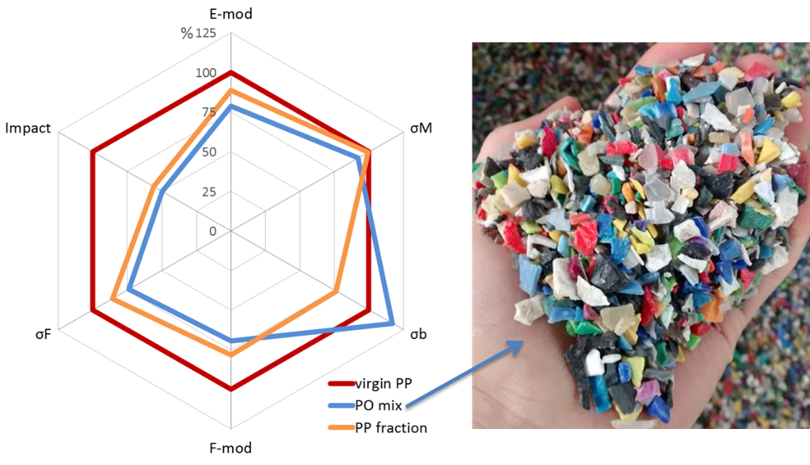
Clean-up of the recycled plastics fraction – Result
PO injection moulding fraction (blend of PP and PE): purification to a 98% PP fraction
Recycled plastics show a 10-20% lower tensile and flexural stiffness compared to the virgin PP grade
Figure 2 Radar plots comparing the mechanical properties of the recycled plastics to virgin PP (left) and illustration of the recycled PO mix regrind.
Notes:
The PO injection moulding fraction (PO mix, see Figure 2 right) is a blend of PP and PE which could already be used in plastic processing, however the mix was further purified to a 98% PP fraction in order to increase the material value. The start mix and sorted PP fraction of the PO injection moulding grade were processed via melt filtration to remove any residual non-melting impurities that could damage pilot scale equipment and/or would impair the FRC’s mechanical properties. The resulting grades were thoroughly characterized and the mechanical properties are presented relative to virgin PP in Figure 2 (left).
The recycled plastics show a 10-20% lower tensile and flexural stiffness compared to the virgin PP grade used as a reference. Moreover, much lower impact strengths were obtained which was expected as the selected virgin PP grade is a high impact grade. Interestingly, compared to the virgin PP grade, both recycled fractions show similar tensile strength but lower flexural strength, while the PO mix fraction has a higher fracture strength.

Slide 7
Fibres from post-producer and post-consumer bulky textile waste
TEST: Precision cut to 2 or 4 mm of post-producer (cotton, polyamide (PA) and polyester (PES)) and post-consumer (mattress textile) waste and optical microscopy check, also for compacted fibres
RESULT: Chemical composition of the mattress textile waste materials:
Post-producer from Delax: >90% PES
Post-consumer from Ecofrag: 90% PES/cotton + PA
Post-consumer from Vanheede: 90% PES/cotton + wool
Notes:
Post-producer (cotton, polyamide (PA) and polyester (PES)) and post-consumer (mattress textile) waste was precision cut by PROCOTEX to 2 or 4 mm fibres using a milling machine. Following these tests, a set of minimum specifications for the raw material for FRC production was defined. The chemical composition of the mattress textile waste materials was determined:
Post-producer from Delax: >90% PES
Post-consumer from Ecofrag: 90% PES/cotton + PA
Post-consumer from Vanheede: 90% PES/cotton + wool
Additionally, optical microscopy was performed in order to evaluate the fibre morphologies and actual lengths Moreover, in order to improve fibre dosing on pilot scale compounding equipment, PROCOTEX has prepared granules of different types of fiber fluff (PES, cotton, jute, aramid) using a fiber compacting machine. These granules were inspected using a microscope with camera and image processing in order to examine the granule size, fibre length and if the fibres are still intact after compacting (see Figure 3).

Slide 8
Development of short fibre reinforced composites - Test
AIM:
optimize the FRC formulation by adding varying fibre types and amounts to a PP matrix
improve fibre/matrix interaction by testing a range of additives (compatibilizers)
PROCESS:
Determination of tensile, flexural and impact properties
Comparison with glass fibre reinforced composites (GFC) and wood plastic composites (WPC).
Notes:
Small and pilot scale compounding trials followed by injection moulding of standard test samples were performed by CENTEXBEL in order to optimize the FRC formulation. Varying fibre types (prepared by PROCOTEX) and amounts were added to a PP matrix. Moreover, a range of additives (compatibilizers) was tested to improve fibre/matrix interaction. Tensile, flexural and impact properties were determined and compared to glass fibre reinforced composites (GFC) and wood plastic composites (WPC).

Slide 9
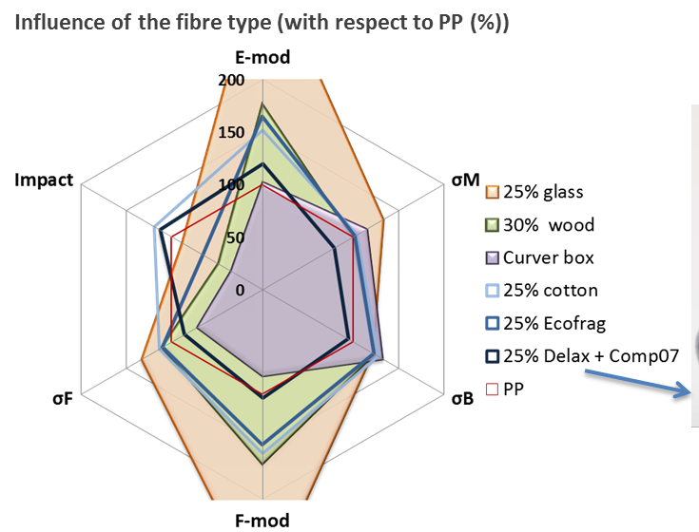
Development of short fibre reinforced composites – Results
General comparison of the mechanical properties of the FRC’s with cotton, Ecofrag and Delax fibres to virgin PP
Improvment of stiffness, fracture, flexural strength and impact resistance upon the addition of cotton fibres
Increasing fibre concentrations results in further enhancement of elastic modulus and strength
Notes:
The results presented in Figure 4 show that the stiffness (i.e. tensile and flexural moduli), fracture and flexural strength as well as the impact resistance were improved upon the addition of cotton fibres. Moreover, increasing fibre concentrations resulted in further enhancement of elastic modulus and strength. The addition of the 2 mm mattress textile fibres also resulted in increased elastic and flexural moduli and thus materials with increased stiffness as well.

Slide 10
Development of short fibre reinforced composites - Results
Specific results:
    Ecofrag: slightly higher fracture and flexural strength
    Delax: reduced impact resistance, increased impact strength but decreased flexural and tensile strength
Varying properties for the different FRC’s might be caused by a combination of different fibre/matrix interaction, different fibre properties and morphologies
Stiffness of the developed FRC’s outperformed by the GFC but comparable or even superior to the WPC material
Notes:
Additionally, the ECOFRAG fibres induced a slightly higher fracture and flexural strength, comparable to the cotton FRC’s. However, a reduced impact resistance was obtained, while the DELAX compound on the other hand showed increased impact strength but decreased flexural and tensile strength. The varying properties for the different FRC’s are likely to be caused by a combination of different fibre/matrix interaction, different fibre properties and morphologies. In terms of stiffness, the developed FRC’s are outperformed by the GFC to a great extent. However, they are comparable or even superior to the WPC material.

Slide 11
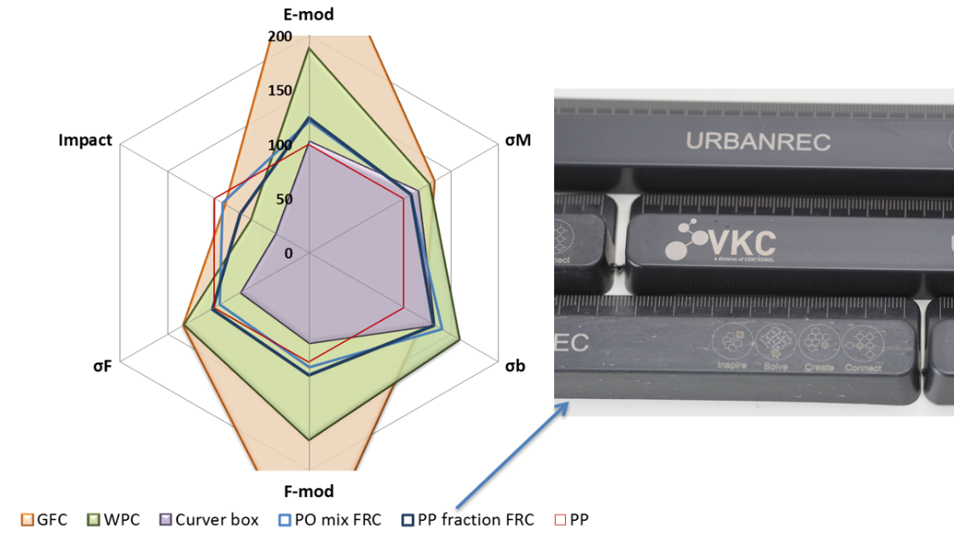
Development of short fibre reinforced composites - Results
Replacement of virgin PP with the recycled plastics (adding the cotton fibres and a compatibilizer)
Improvement of the mechanical properties with higher tensile, flexural moduli, strengths than virgin PP grade
Notes:
Furthermore, virgin PP was replaced with the recycled plastics obtained by VANHEEDE and rulers were produced as demonstrators (see Figure 5). Adding the cotton fibres and a compatibilizer resulted in a considerable improvement of the mechanical properties. The tensile and flexural moduli and strengths even exceed those of the virgin PP grade.
Figure 5 Radar plot comparing the mechanical properties* of the recycled plastics FRC's to unfilled, virgin PP and to virgin WPC and GFC (left) and illustration of the demonstrators produced from the PO mix FRC (right).
*including elastic modulus (E-mod), tensile strength (σM), strength at break (σB), flexural modulus (F-mod), flexural strength (σF) and impact strength (Impact)

Slide 12
Development of short fibre reinforced composites - Results
Compounding and injection moulding FRC (with mattress textile fibres) compared to GFC and WPC and store-bought curver box
GFC highly outperforms the FRC
Better overall performance of WPC
FRC containing compatibilizer has higher stiffness, flexural and impact properties than store-bought curver box but similar tensile strength
Notes:
Ultimately, compounding and injection moulding of the final demonstrator, a storage box, was performed. For this purpose, mattress textile fibres from VANHEEDE were selected as these were actual post-consumer bulky waste. In Figure 6Error! Reference source not found. the properties of the 2 mm mattress fibre-FRC’s are again compared with the GFC and WPC produced at CENTEXBEL as well as with the store-bought curver box. As expected, the GFC outperforms the FRC’s to a great extent, however also the WPC shows a better overall performance. Nevertheless, the FRC containing compatibilizer is definitely suitable for the production of storage boxes as it shows higher stiffness, flexural and impact properties than and similar tensile strength as the store-bought curver box.

Slide 13
Development of short fibre reinforced composites – Next steps
Determination of the mechanical properties of the produced boxes to optimize the product properties
Industrial scale compounding to investigate if the fibres can still be distributed homogeneously using large scale extruders
Life cycle analysis of the developed demonstrator(s)
Selection of an ecolabel
Notes:
Next steps will include determination of the mechanical properties of the produced boxes as the injection moulding parameters might require further adjustment to optimize the product properties. Additionally, as the compounding was performed on semi-industrial scale, future work should include industrial scale compounding to investigate if the fibres can still be distributed homogeneously using large scale extruders. Furthermore, life cycle analysis will be performed for the developed demonstrator(s) and an ecolabel will be selected.

