Slide 1
Fragmentation of bulky waste
Notes:
This document summarizes deliverable “Report of the implementation of the fragmentation technology for bulky waste”; this task was performed by ECOFRAG, starting June 2016 (Month 1 of the URBANREC project) and ending May 2017 (Month 12 of the project).
The report aims at providing a brief presentation of how the laminated cutting technology (fragmentation) to separate materials and products (urban bulky waste) works, as well as the adaptation to different urban bulky waste types.
Besides, this document shows the main aspects for the construction of the pilot plant and its adaptation, including the technology, for the urban bulky waste, as well as the results of the fragmentation tests obtained, to achieve the validation for industrial valorization.

Slide 3
Objectives of the fragmentation plant
Urban bulky waste (e.g. received from civic amenity sites) to be dismantled: e.g. mattresses, furniture, seats, chairs, etc.
Objective to separate their components in different fractions like textiles, foams, metals, plastics or wood, via laminated cutting technology.
However, it has not been tested for the streams proposed in URBANREC and this implies that the process and components need to be adapted for each one.
Pilot plant is built including a sequence of equipment, instruments, accessories and lines, arranged in a logical form to reproduce and simulate the real industrial process.
Notes:
Once the required urban bulky waste is received from the city amenities sites (CA sites), it must be dismantled to reduce its size and to separate their components in different fractions. Dismantling of remaining bulky wastes such as mattresses, furniture, seats, chairs, etc. can generate an interesting large amount of recovered materials such as textiles, foams, metals, plastics or wood. To reduce their size there are different technologies available, that comprise a wide range of machines for preparation of all soft to medium hard, hard, brittle, tough, elastic or fibrous materials.
Between the different technologies available, laminated cutting technology for grinding has been selected in this project to demonstrate its effectiveness for urban bulky waste recovery. This technology has been tested previously for the fragmentation of different multimaterial products by ECOFRAG such as tyres, and cabling. This technology uses water in high pressure conditions to cut the materials. The advantages compared with other technologies, is that it allows to obtain clean and differentiated components easier to recycle at higher speed, and it can be implemented in conditions where there is a high production reducing the energetic consumption and machinery maintenance needs. However, it has not been tested for the streams proposed in URBANREC and this implies that the process and components need to be adapted for each one.
To test this technology, a pilot plant was built in Agullent (Valencia, Spain). A pilot plant is an experimental installation including a sequence of equipment, instruments, accessories and lines, arranged in a logical form to reproduce and simulate the real industrial process. To start the operations, the desired products and their characteristics (such as size, water content or presence of contaminants) must be defined. In example, for mattresses it is necessary to separate foams as latex, polyurethane or mixed foams, while in textiles, different compositions can be obtained (cotton, viscose, sisal…and thermoplastic material). These characteristics were given by the partners, to obtain products that are valuable for the posterior processes

Slide 4
Demonstrative operations: Fragmentation tests (1)
Stage 1
Stage 2
Separation. The waste is separated manually by members of the ECOFRAG staff, depending on the type of material (wood, plastic, textile, etc.), weight and size.
Stage 3
Cutting step: This step is necessary for big pieces (more than 90 cm width), to be later sent to the fragmentation setting.
Reception of material. The samples of solid waste (sofas, mattresses, mixed furniture, hard plastic, tyres, etc.) are received in standard containers and located separately.
Stage 4
Fragmentation: the cutting laminated technology is finally used to reduce the separated waste materials to the required size, adjusting different parameters: water pressure and quantity, advance speed, etc.
Stage 5
Drying process: the excess of water is removed from the treated material.
Notes:
Once the required urban bulky waste is received from the CA sites, the process in ECOFRAG facilities is performed as follows:
•Reception of material. The samples of solid waste (sofas, mattresses, mixed furniture, hard plastic, tyres, etc.) are received in standard containers and located separately.
•Separation. The waste is separated manually by members of the ECOFRAG staff, depending on the type of material (wood, plastic, textile, etc.), weight and size.
•Cutting step: This step is necessary for big pieces (more than 90 cm width), to be later sent to the fragmentation setting.
•Fragmentation:Thecuttinglaminatedtechnologyisfinallyusedtoreducetheseparatedwastematerialstotherequiredsize,adjustingdifferentparameters:waterpressureandquantity,advancespeed,etc.
•Drying process: the excess of water is removed from the treated material.

Slide 5
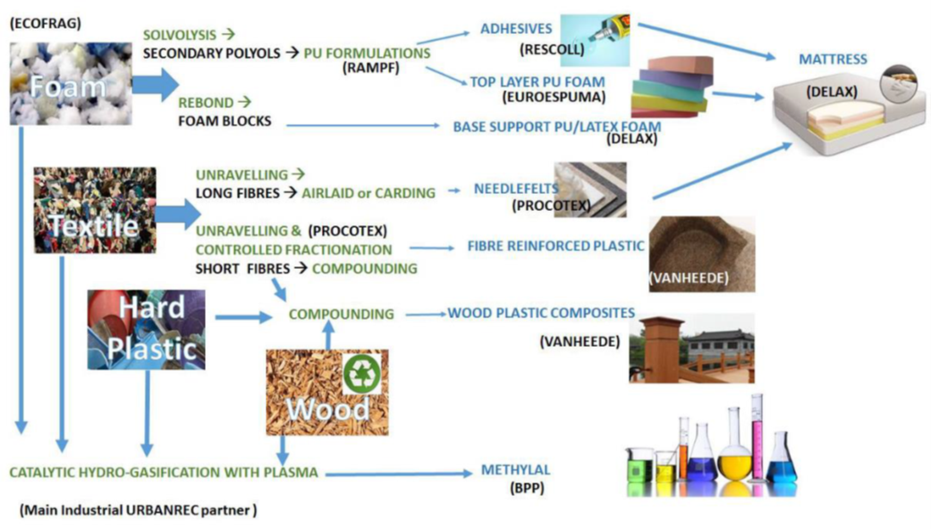
Demonstrative operations: Fragmentation tests (2)
Notes:
Finally, the material obtained is stored in big bags and shipped to the project partners for posterior processes of the URBANREC Project

Slide 6
Results of bulky waste fragmentation
Mattresses
Mixed furniture
Hard plastics (fruit baskets, chairs, and tables)
Carpets made from cellulose, mainly jute,
Textile and others
Mixture of FOAM & TEXTILE coming from mattresses with spring:
TEXTILE and FOAM material coming from Latex mattresses
Latex foam
Artificial grass also tested (currently urban bulky waste)
Tyres → rubber, metal parts, and textile.
FOAM coming from mattresses without spring:
Wood furniture (sofas, chairs and tables)
Upholstery,clothes, carpets, tyres
Carpets made from synthetic fibres (polyamide)
Notes:
The bulky waste treated using this technology is mainly mattresses (latex, spring mattresses, etc.), mixed furniture and upholstery, clothes, mattresses top layer, carpets, hard plastic and tyres.

Slide 7
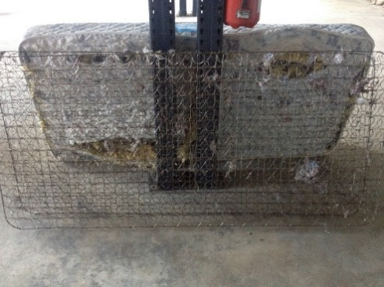
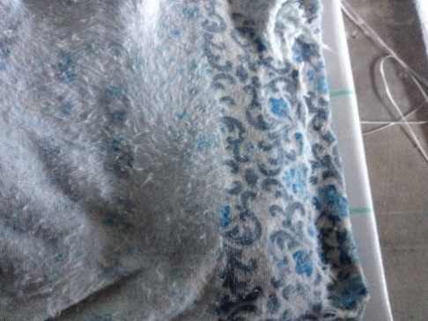
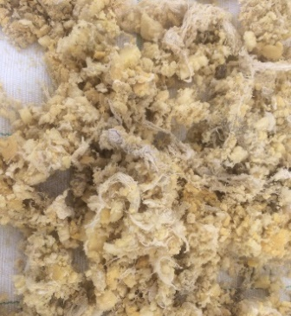
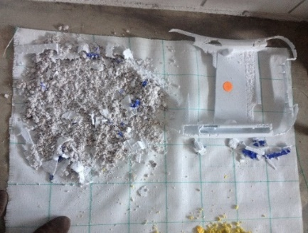
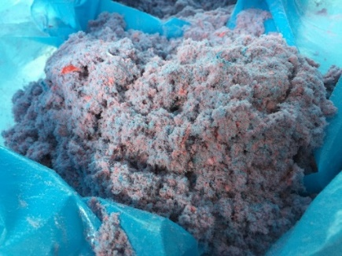
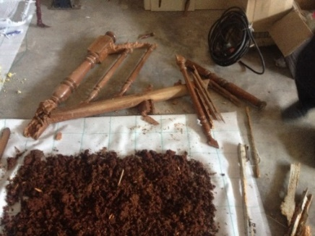
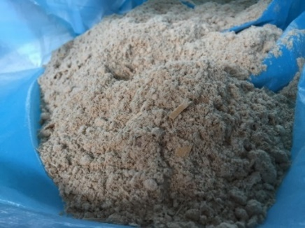
Results of bulky waste fragmentation
Fragmentation of mattresses: metal parts (springs), textile and foam
Plastic (up) and Wood(down) furniture before and after fragmentation

Slide 8
Conclusions
Implementation and adaptation of the fragmentation technology carried out according to expectations
Results of the analysis contribute to better adjust and optimize the cutting lamination process
Technology’s advantages: cleanness, purity, small size of some samples, together with the capability to easily separate different materials in some cases.
Notes:
The implementation and adaptation of the fragmentation technology has each been carried out correctly, and the results of the analysis contribute to better adjust and optimize the cutting lamination process, and to understand the needs of valorisation route. The technology has shown advantages after the first tests, among them the cleanness, purity, small size of some samples, together with the capability to easily separate different materials in some cases.

