Slide 1
Mobile app and customer portal development in
Harelbeke-Flanders regions
Notes:
This presentation is based on results obtained in URBANREC’s deliverable 5.4: “Mobile app and customer portal development in Harelbeke-Flanders regions”. The app has been developed by IMOG.

Slide 3
Mobile app’ for citizens’ bulky waste – Aims
Bridge the gap between citizens in Flanders, the re-use centre (dismantling service and collection re-useable items), and IMOG (bulky waste collection and treatment)
New way of communicating
Targeted communication actions:
      Push-messages for raising awareness on avoiding bulky waste and increasing re-use and recycling
      Specific communications on updates and special events per user-group
Notes:
IMOG developed a new mobile app that is especially devoted to citizens’ bulky waste management.
This app is bridging the gap between the citizens in our region, the re-use centre (dismantling service and collection re-useable items), and IMOG (bulky waste collection and treatment).
The new mobile app creates another way of communication with the citizens. It offers the possibility to conduct targeted communication actions, such as:
Push-messages for raising awareness on avoiding bulky waste and increasing re-use and recycling
Specific communications on updates and special events per user-group

Slide 4
Mobile app’ for citizens’ bulky waste – Services to citizens
Info-pages on prevention and sorting guidelines
Locations of CAS and re-use centers
Price-calculation tool
Tool for reserving different services from IMOG (for recyclable and waste items) and re-use centre (for re-usable items and dismantling service)
Notes:
The app includes services for the citizens like:
info-pages on prevention and sorting guidelines
locations of CAS and re-use centers
a price-calculation tool
a tool for reserving different services from IMOG (for recyclable and waste items) and re-use centre (for re-usable items and dismantling service).

Slide 5
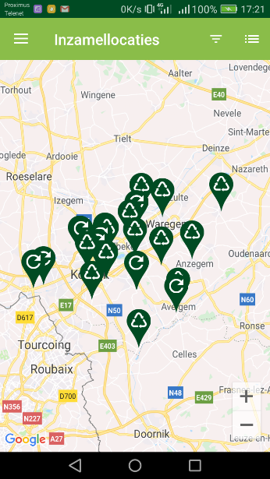
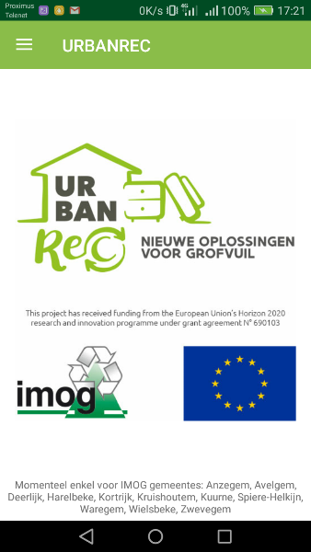
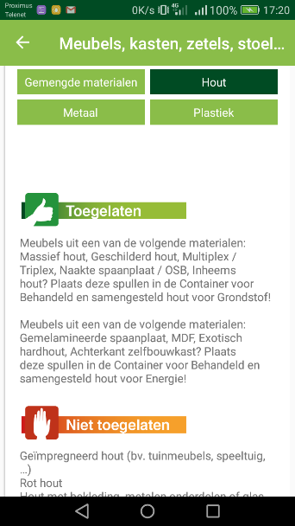
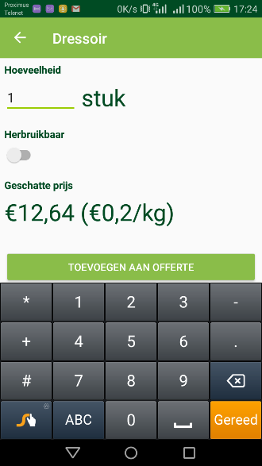
Mobile app’ for citizens’ bulky waste – General overview
Home page
Prevention guidelines
Sorting guidelines
Locations of collection sites
Services – overview
Services – Price indication
Settings
Notes:
The app is composed of seven sections with divers subsections:
Home page
Prevention guidelines
Sorting guidelines
Locations of collection sites
Services – overview
Services – Price indication
Settings

Slide 6
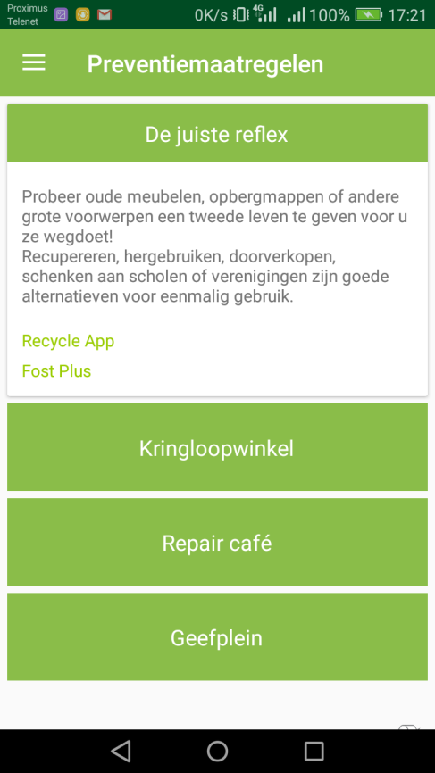
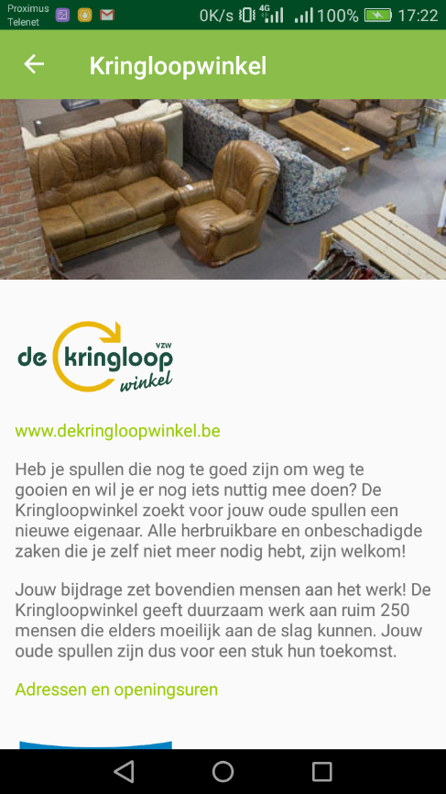
Mobile app’ for citizens’ bulky waste – Prevention Guidelines
Start page
Option Kringloopwinkel

Slide 7
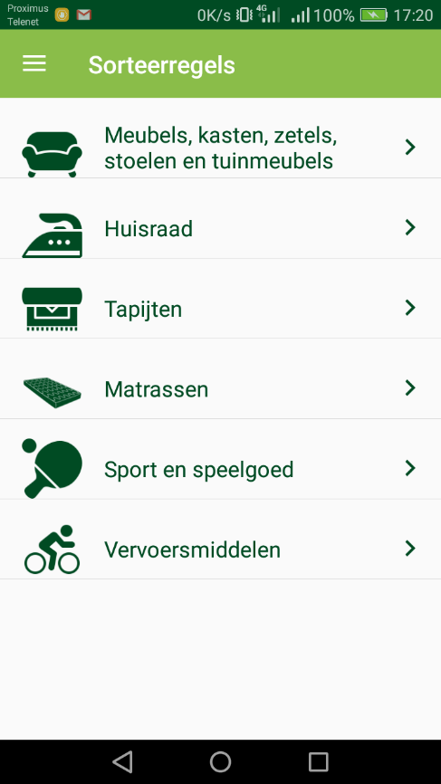
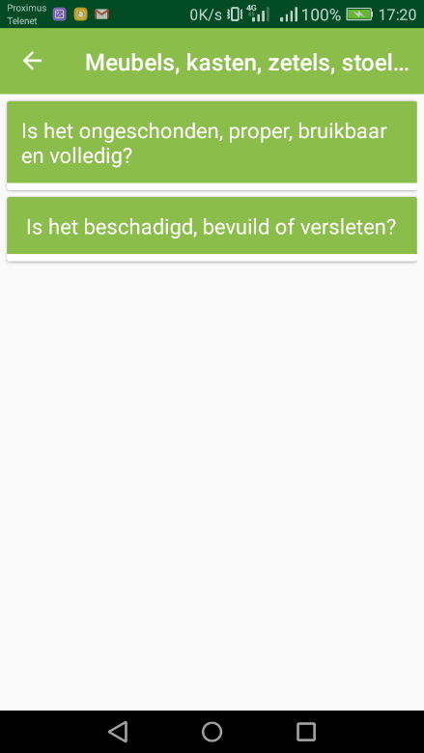
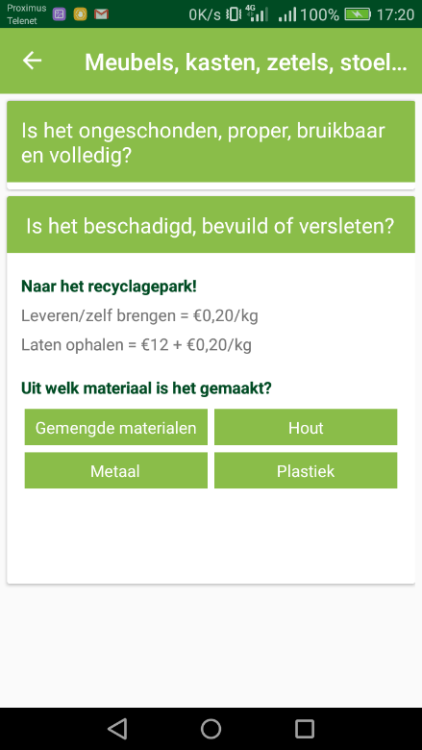

Mobile app’ for citizens’ bulky waste – Sorting Guidelines
Start page
Selection of bulky household items

Slide 8
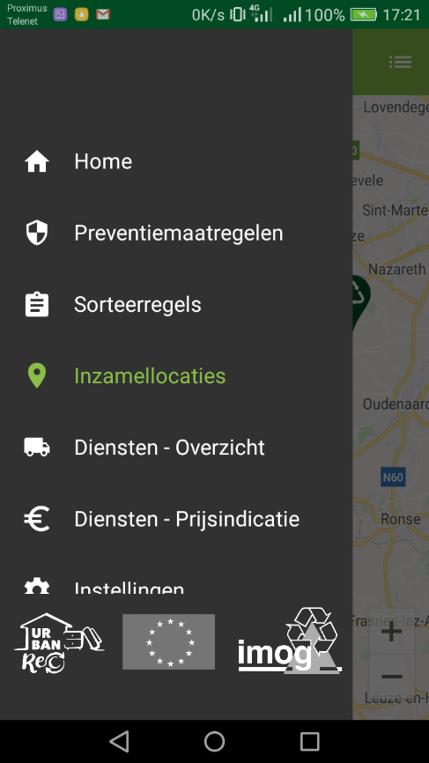
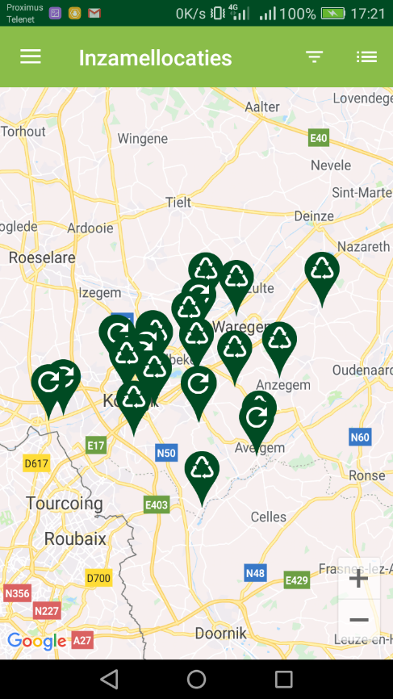
Mobile app’ for citizens’ bulky waste – Collection Locations

Slide 9
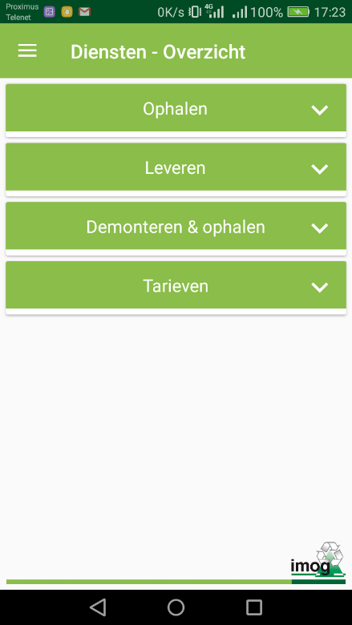
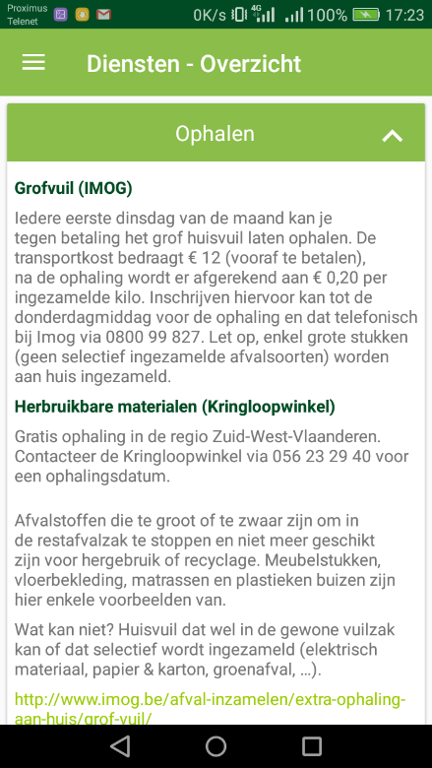
Mobile app’ for citizens’ bulky waste – Services Overview

Slide 10
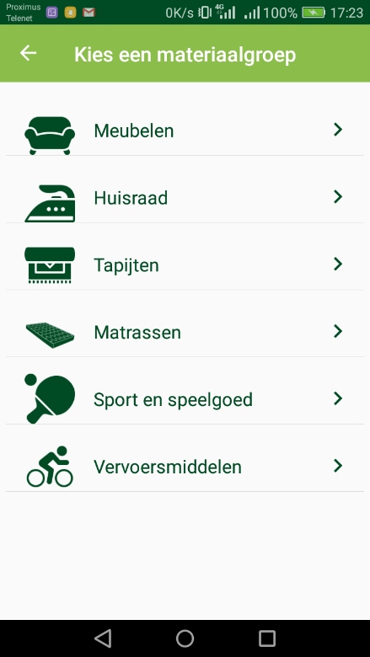
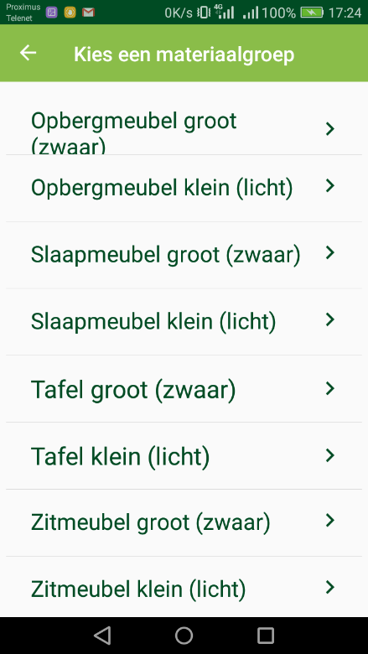
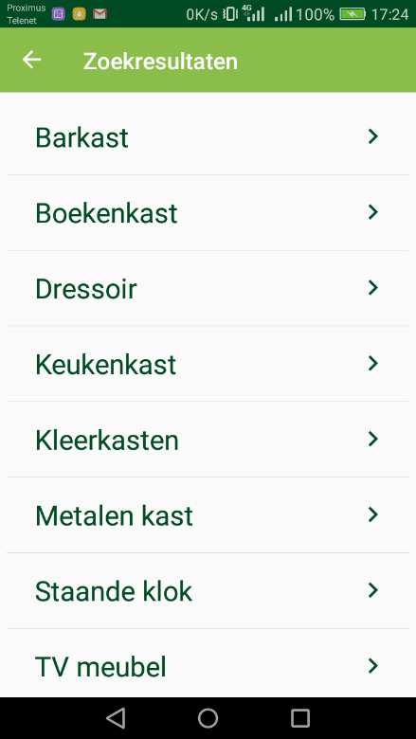
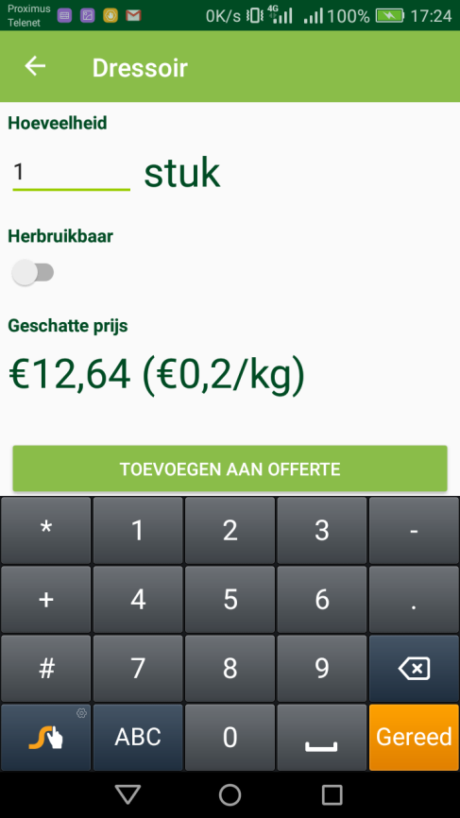
Mobile app’ for citizens’ bulky waste – Services Price Indication
Selection of bulky household items and indication of amount of chosen
specific bulky household items

Slide 11
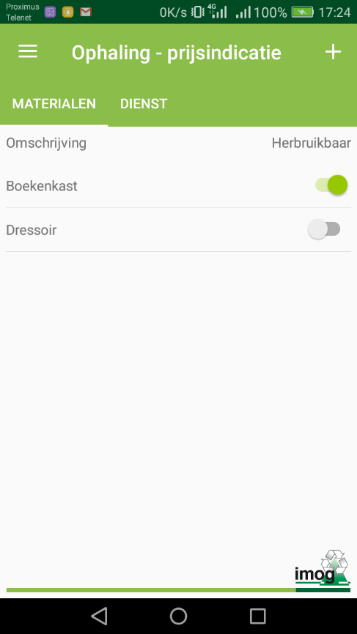
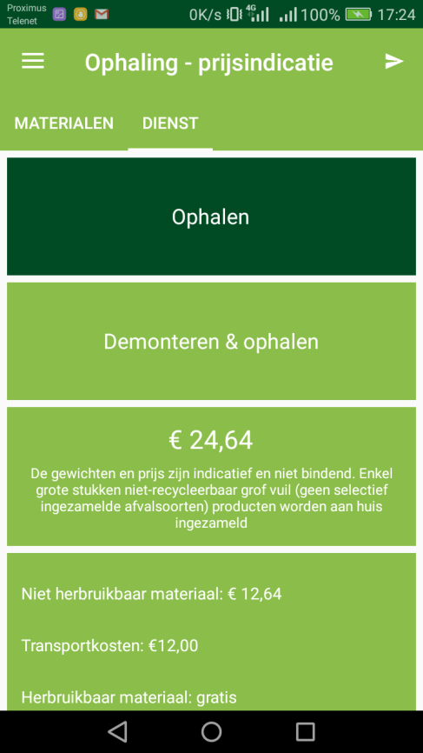
Mobile app’ for citizens’ bulky waste – Services Price Indication
Overview chosen specific bulky household items, with indication of re-usable (herbruikbaar)
Options for selecting a service, including conditional price indication

Slide 12
Mobile app’ for citizens’ bulky waste – Availability
Available in app-store (iOS) and play-store (Android) since January 2018 for the citizens of the IMOG-region
Source code of the mobile app adaptable and transferrable to other regions in Europe
Contacts:
Mr. Koen Delie, Director External Affairs, koen.delie@imog.be
Ms. Bianka Kühne, Sustainability coordinator, ianka.kuhne@imog.be
Notes:
The app is available in app-store (iOS) and play-store (Android) since January 2018 for the citizens of the IMOG-region. The source code of the mobile app is adaptable and thus transferrable to other regions in Europe. For more information please contact IMOG (see contact details below).

Slide 13
Implementing a customer portal service – Principle
Innovative system to collect data on recycle patterns of citizens with specific focus on bulky waste
Collection of data at city amenity sites
Data analysis and identification of recycle patterns
Development of specific communication and educational activities targeted to specific groups of citizens
Notes:
IMOG developed a new customer portal service. This is an innovative system to collect data on recycle patterns of citizens with specific focus on bulky waste. The data are collected at the city amenity sites where 90% of the recyclable material is collected in the IMOG-region. After data analysis and identification of recycle patterns, specific communication and educational activities can be developed targeted to specific groups of citizens.

Slide 14
Implementing a customer portal service – Campaigns
Communication and educational campaigns with a focus on the reduction of fractions with the highest handling costs or related to high environmental impact:
bulky waste made of mixed materials (recycling)
bulky waste for incineration (energy recovery)
bulky waste for landfill (inert materials)
Notes:
The communication and educational campaigns focus on the reduction of fractions with the highest handling costs or related to high environmental impact:
bulky waste made of mixed materials (recycling)
bulky waste for incineration (energy recovery)
bulky waste for landfill (inert materials)

Slide 15
Implementing a customer portal service – Aims
Develop targeted communications to specific groups of citizens thanks to insights in the recycle patterns
Encourage the citizens to reduce bulky waste and to contribute to a better bulky waste management
Allow municipalities to make objective policy decisions for specific waste management actions based on the assessment of recycle patterns
Notes:
The insights in the recycle patterns provide possibilities to communicate to and to educate specific groups of citizens. The aim is to encourage the citizens to reduce bulky waste and to contribute to a better bulky waste management. Furthermore, assessing the recycle patterns it allows the municipalities to make objective policy decisions for specific waste management actions.

Slide 16
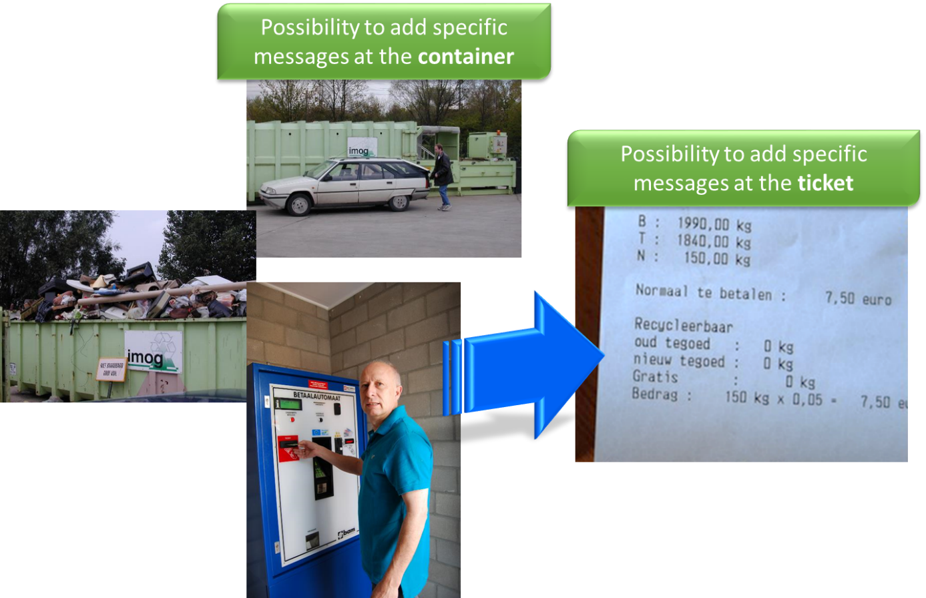
Implementing a customer portal service – Example
Notes:
Possible points for communications are for instance the specific container and/or the ticket that the citizens receives when he finishes his/her visit at the CAS – tailored to only those citizens that brought these kinds of fractions.

