Slide 1
Wood plastic composites from recycled hard plastics and wood
Notes:
This presentation is based on results obtained in URBANREC’s deliverable 3.4: “Wood plastic composites from recycled hard plastics and wood”, achieved within the framework the Work Package – Wood Plastic Composites aiming to manufacture WPC compounds using bulky recycled hard plastic and wood wastes, and to validate industrial manufacturing of WPC products to alleviate solid waste problem by using them as a resource..

Slide 3
What is Wood Plastic Composites
WPCs = hybrid materials composed of wood flour and thermoplastic polymers (reusable plastics)
Lightness, processability and durability of wood combined with molding capability and environmental resistance of plastics
Advantages of wood as fibrous material in WPC: low cost, wood-like appearance, eco-friendly renewable filler
Notes:
WPCs can be defined as hybrid materials composed of wood flour and thermoplastic polymers. Thermoplastic polymers are reusable plastics that contribute to decreasing the waste, efficient usage of natural resources and energy. Wood as a fibrous filler material in WPC provides several advantages such as low cost, wood-like appearance, and eco-friendly renewable filler. Production of a WPC emits less greenhouse gas CO2 per unit volume than a virgin plastic¹⁻³. WPC combines the advantages of lightness, processability and durability properties of wood, and molding capability and environmental resistance of plastics. Molding capability of plastics enhances the application areas of WPCs due to easiness in plasticity.

Slide 4
Global Production of Wood Plastic Composites
Appreciable growth of WPCs market in the last decade
Exponential increase of research and development activities and diverse application of WPCs in various fields
Largest share in WPCs market:
  Building and construction applications (sidings, decks, fences)
  Automotive industries (seat backs, headliners, front and rear door linens, boot linens, parcel shelves)
Notes:
One of the priorities in the European Community development strategy is to obtain more sustainable products by reserving natural resources and avoiding harmful chemicals. Therefore, WPCs play a major role in sustainable development. The market for WPCs in the last decade is showing appreciable growth. As a result, research and development activities and diverse application of WPCs in various fields have also increased exponentially. In the global WPCs market, the demand increase is mainly a result of their use in building/construction and automotive industries. Nowadays building and construction applications have the largest share in WPC market because of product performance in durability, maintenance cost as compared to conventional materials. WPCs are eco-sustainable and long lasting materials used in many daily use commodities in exterior and interior construction products such as sidings, decks, and fences. In the automotive industry WPCs are found in seat backs, headliners, front and rear door linens, boot linens, and parcel shelves, among others.

Slide 5
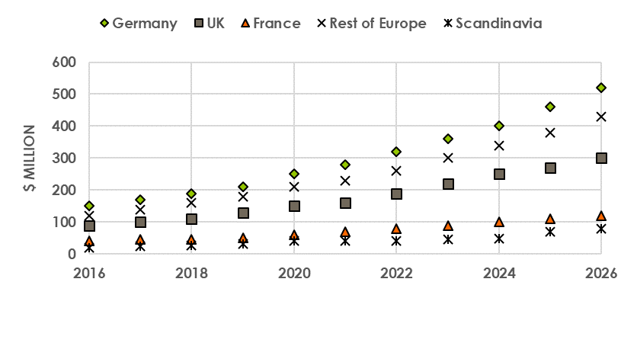
Forecast of Wood Plastic Composites Production
Five-year average growth rate for WPCs:
      35% in China
      11% in Europe
      8% in North America
European WPC market in 2020: ca. $850 million
Global WPC market anticipated growth: from $3652.6 million in 2017 to $10751.4 million by 2026, at a CAGR of 12.79%
Notes:
Five-year average growth rate for WPCs is approximately 35% in China, followed by 11% in Europe, and 8% in North America. European WPC market will be approximately $850 million in 2020 as shown in Figure 1. Global WPC market is anticipated to grow from $3652.6 million in 2017 to $10751.4 million by 2026, at a CAGR of 12.79%.

Slide 6
Why Wood Plastic Composites From Bulky Waste
Reduce the environmental effects of plastics
Reserve natural resources
Support circular economy for sustainable production and consumption
URBANREC priorities:
demonstrating industrial manufacturing of WPC products from bulky waste
Showing that WPC are comparable to market available products and suitable for use in different applications
Notes:
Using waste as a resource is one of the goals for the realisation of the circular economy according to greening strategy in the European community. Most of the plastic wastes are intrinsically non-biodegradable, requiring escalated recycling to overcome ever-increasing consumption of plastics. It is reported that 55% in plastic recycling rate is needed to obtain a 10% decrease in municipal waste landfilling rate by 2030 considering the population growth rate⁴.
URBANREC project targeted production of WPCs from recycled plastics of bulky waste and wood waste to reduce the environmental effects of plastics, reserve natural resources, and support circular economy for sustainable production and consumption.
One of the priorities in the URBANREC project is demonstrating industrial manufacturing of WPC products from bulky waste, which are comparable to market available products and suitable for use in different applications.

Slide 7
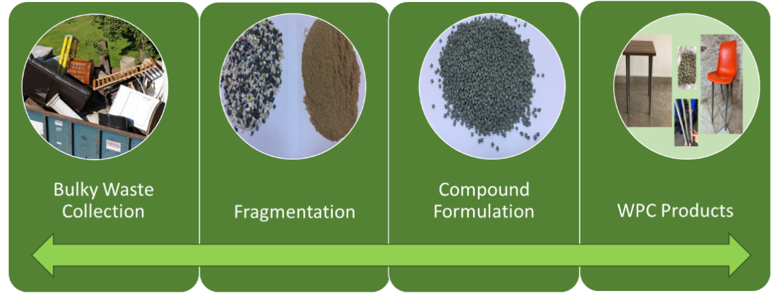
WPC production from recycled plastics and wood waste
Composition of recycled polypropylene (PP) and Polyethylene (PE) obtained from bulky waste with wood waste at various filler composition with required modifiers and other additives
Comparison of the various required specifications for WPC base material
Industrial application of WPC products by injection molding technology
Notes:
Fragmented recycled polymers and recycled wood waste were supplied by the project partners (Vanheede-Belgium). Recycled polypropylene (PP) and Polyethylene (PE) obtained from bulky waste were compounded with wood waste at various filler compositions with required modifiers and other additives. First, optimum WPC formulations were determined in lab scale. The optimum formulations were obtained by comparing various specification requirements for WPC base materials. Then, industrial applications were achieved by injection molding technology. The use of recycled plastics is beneficial for the industry because it also leads to cost reductions with lower processing temperatures and lower energy consumption.

Slide 8
Conclusions
Definition of optimum compositions of wood and other additives in WPC
Industrial scale applicability evidenced by manufacturing several WPC products
Product properties at the levels presented by similar products made from virgin plastics
Applicability of WPCs from recycled bulky waste in urban furniture and/or consumer goods sectors, in addition to other potential areas such as automotive, construction, and building
Notes:
One of the priorities in URBANREC project is demonstration of the industrial production of WPCs from bulky waste for benefits of reserving natural resources, reducing the environmental effects of waste plastics, and supporting circular economy for sustainable development. The optimum compositions of wood and other additives in WPC were determined. Industrial scale applicability was evidenced by manufacturing several WPC products. The product properties are at the levels presented by similar products made from virgin plastics available in the market. The demonstrations carried out in this study indicate the applicability of WPCs from recycled bulky waste in urban furniture and/or consumer goods sectors, in addition to other potential areas such as automotive, construction, and building.

